Slide 1
VIRTUAL FASHION STYLIST APP
USING GEN AI

Slide 2
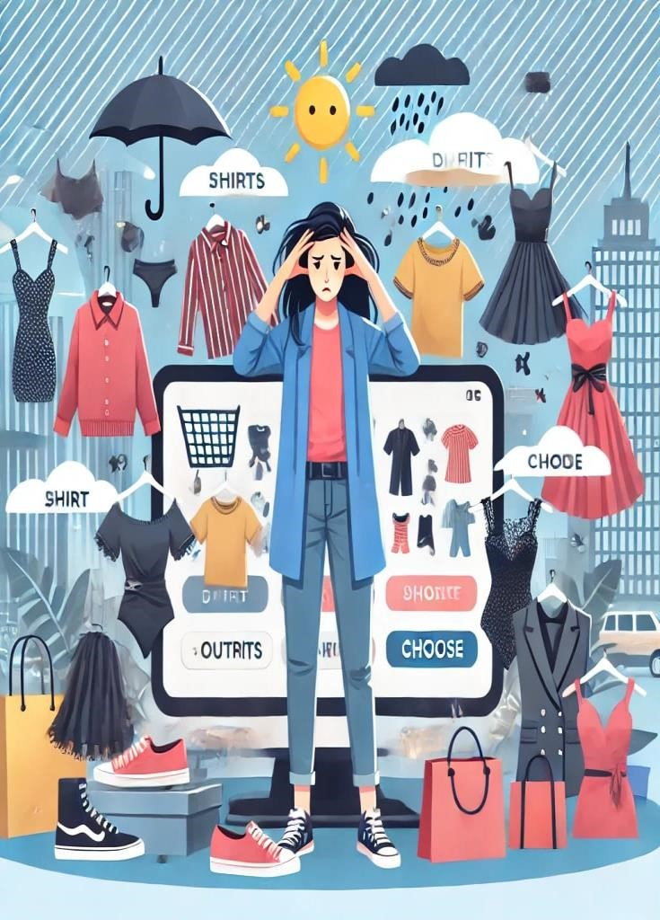

Slide 3
